Slide 1

CMN 1160A – Introduction to Media Studies
Week 2B: Communication: Social and Cultural Forms
Daniel J. Paré
University of Ottawa, Department of Communication
September 15, 2016
Notes:
1

Slide 2
Preview
Defining Society and Culture
Notion of the Public Sphere
Social Roles of Media
Notes:
2

Slide 3
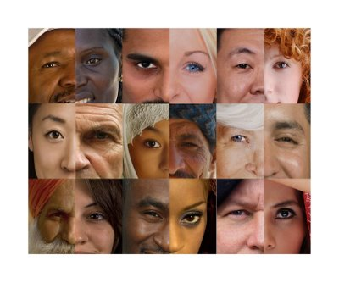
Society, Culture and Media
Society:
the body of institutions and relationships within which people live, and
the conditions in which such relationships are formed
Culture:
the process of intellectual, spiritual, and aesthetic development,
the works and practices that arise from this development, and
a particular way of life

Slide 4

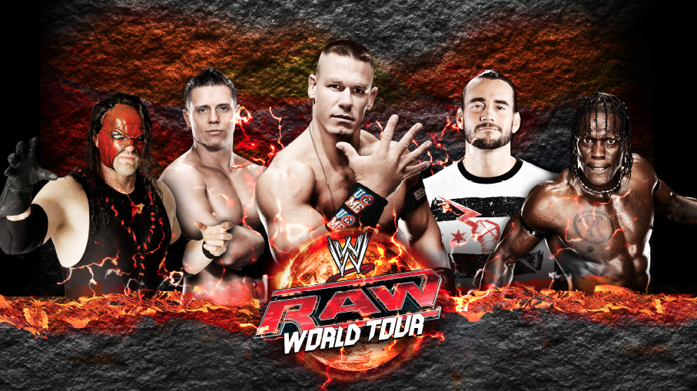
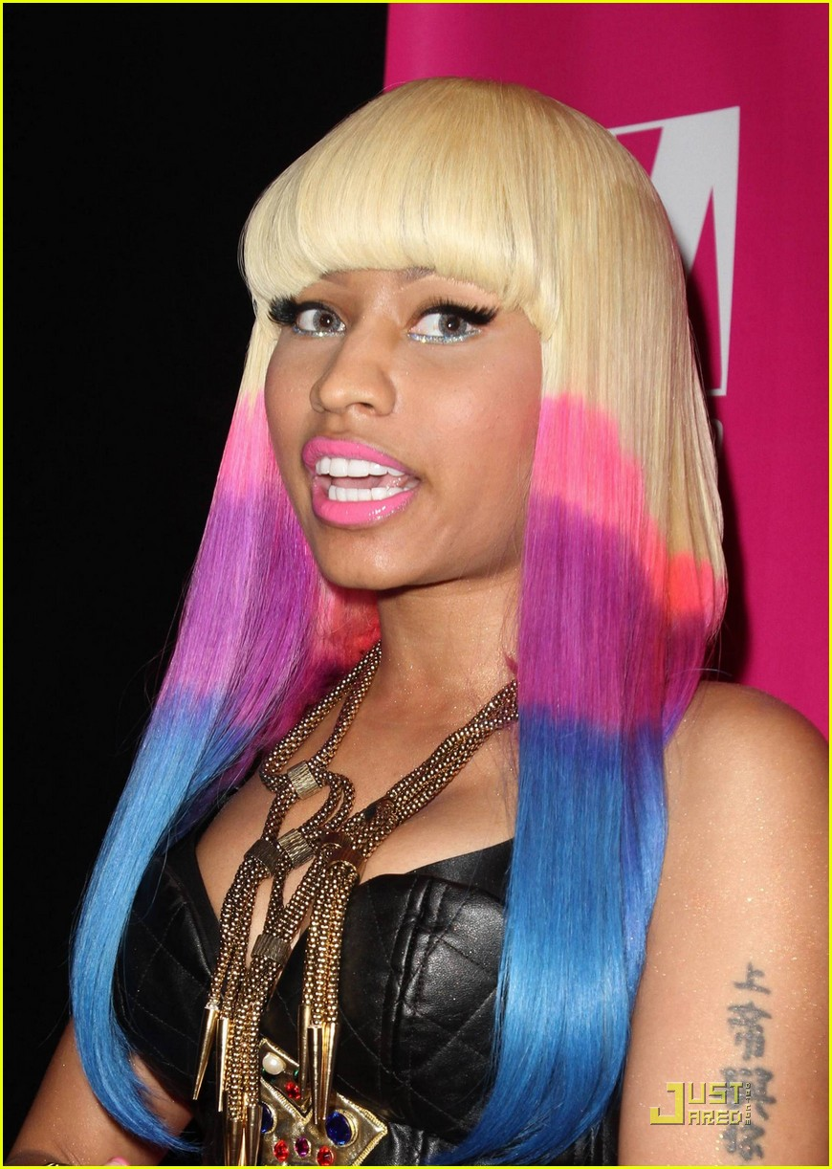

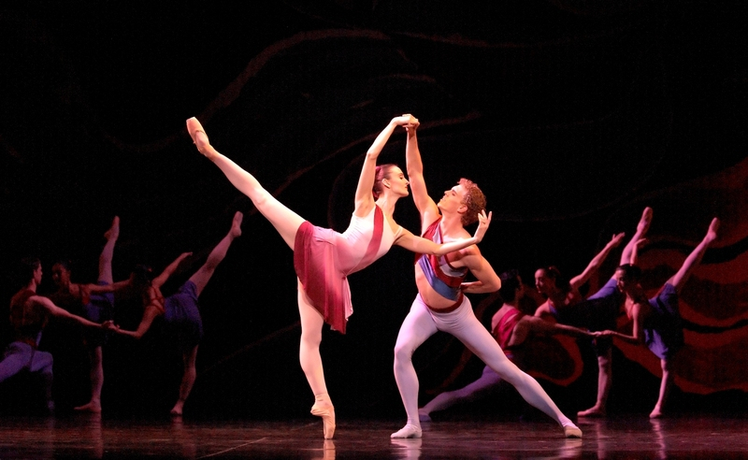
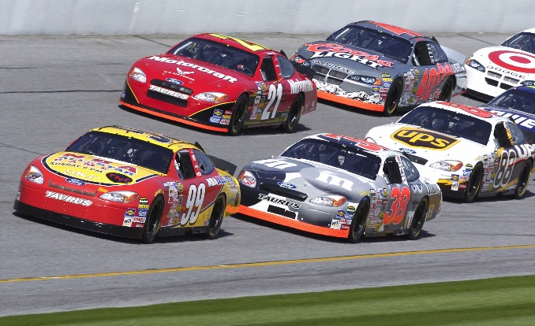

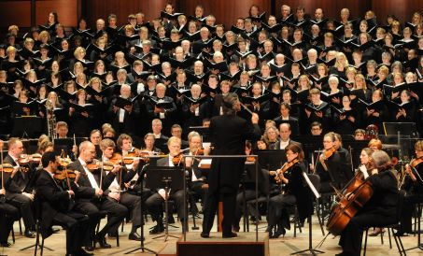
VS.

Slide 5
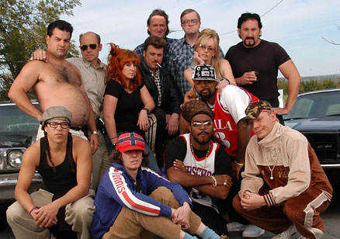

Slide 6

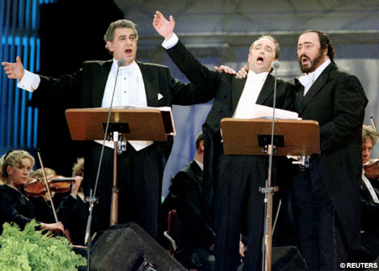

Slide 7



Slide 8
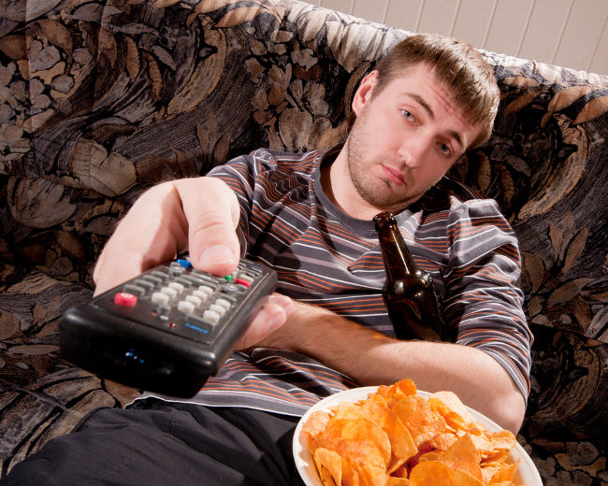
Threat to Canada?

Slide 9
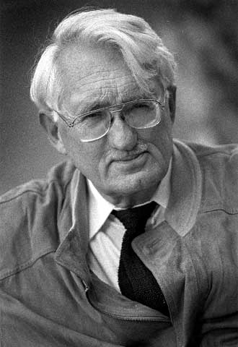
Social Roles of Media
THE STATE
Culture
Media
Jurgen Habermas
Universities/debating societies
Café society/salons
THE MARKET
Notes:
Habermas is a major advocate of the need to create ‘spaces’ for public discourse
Think of public sphere as a ‘marketplace of ideas’

Slide 10
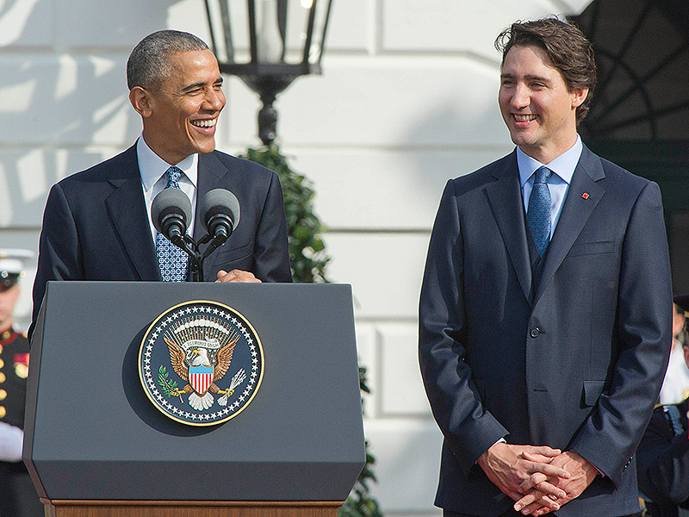
Social Roles of Media - Politics
Notes:
Does media ownership grant permission to control editorial perspective?
Government may control media directly
Freedom of information vs. privacy concerns

Slide 11
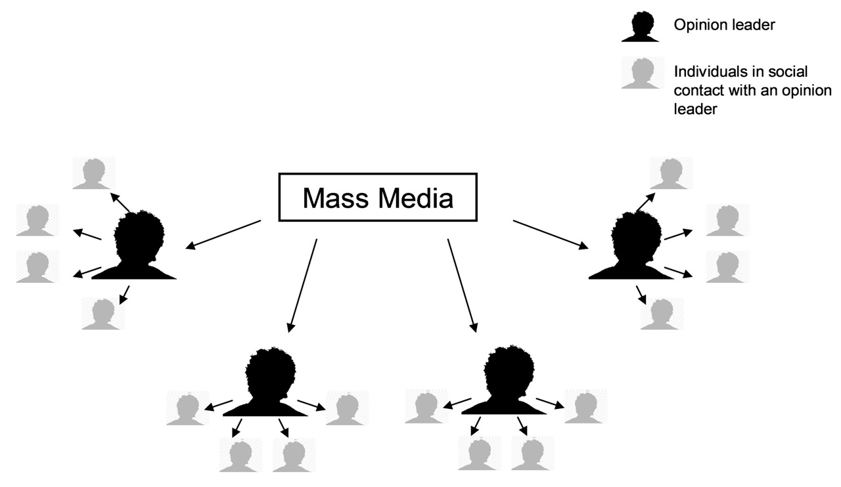
Social Roles of Media - Politics
Two-Step Flow Model
Developed by Katz and Lazarsfeld (1955)
‘Opinion leaders’: people with better access to and understanding of the media
These people transmit information to the greater population and are seen as key media/information players.

Slide 12
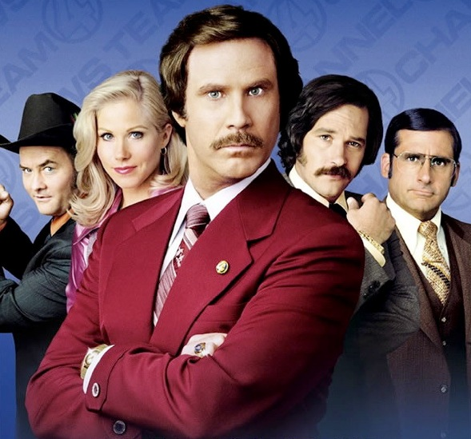

Social Roles of Media - Politics
Media obsessions
Politics
Conflict
Scandals
Horse races
Brevity

Slide 13
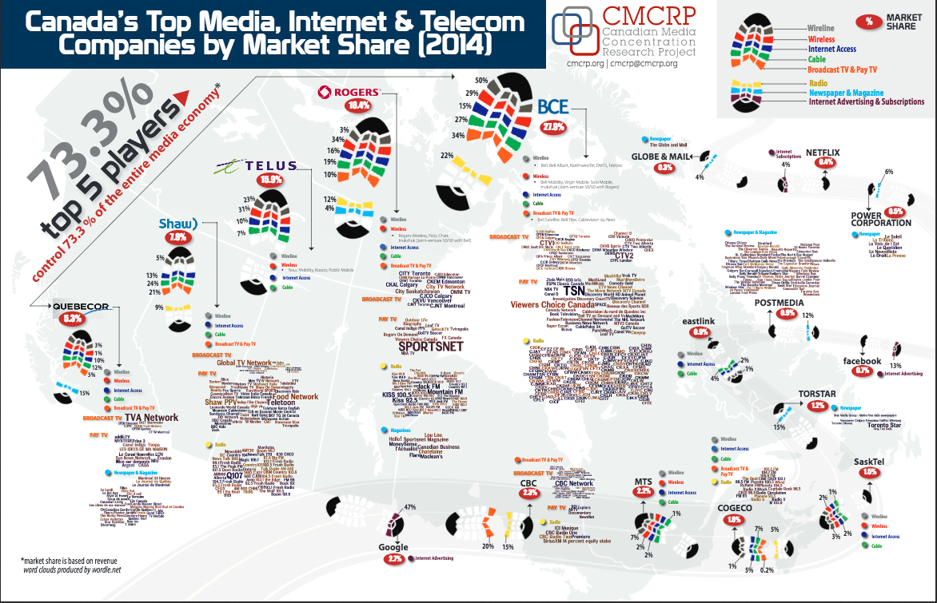

Slide 14
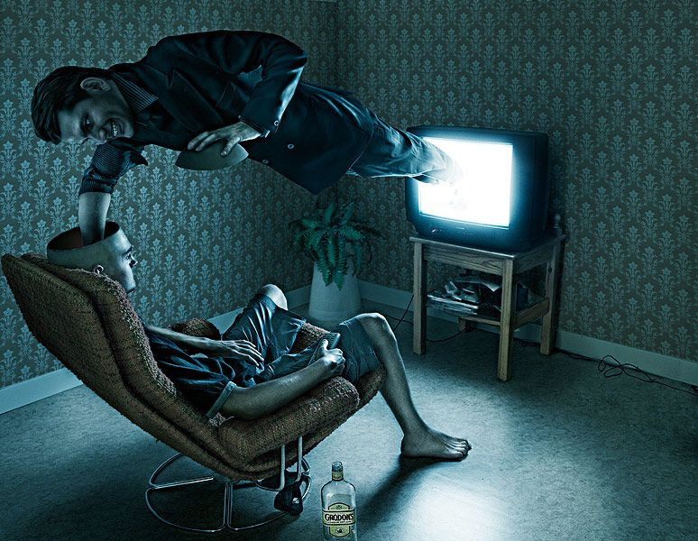
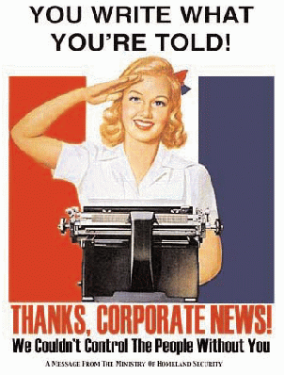
Social Roles of Media - Economics

Slide 15
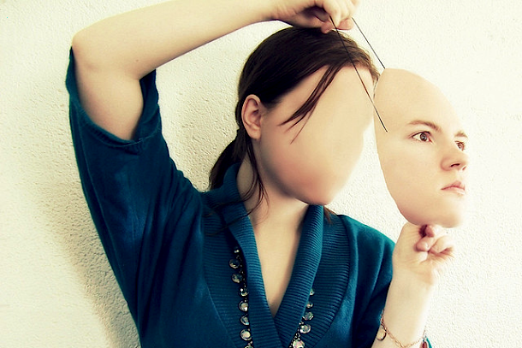
Social Roles of Media - Identity
We construct our identities through social interactions.
Media allows us to explore the world and our relationships to it.
Does media encourage consumerist values?

Slide 16
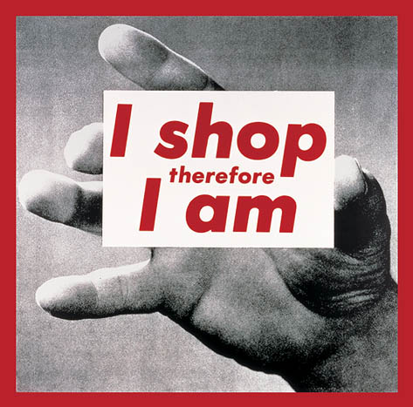
Social Roles of Media - Identity

